Slide 1
Unit 5
Credit, Taxes, Insurance, Review

Slide 2
How your Credit Score is Determined

Slide 3
What your Credit Score Means to Lenders
579 or Less
Risky borrower
580 to 669
Some lenders will approve loans with this score
670 to 739
740 to 799
800
Most lenders consider this a good score
Lenders view you as a very dependable borrower
Lenders view you as an exceptional borrower

Slide 4
Interest
Annual percentage rate (APR) is the annual rate charged for borrowing funds
Fixed Rate- Will not rise or fall during the term of the loan
Variable Rate- Will rise and or fall during the term of the loan.
Simple interest- Only applies to the original amount borrowed.
Compound Interest- Applies to both the principal as well as accrued interest on the principal.

Slide 5



Slide 6
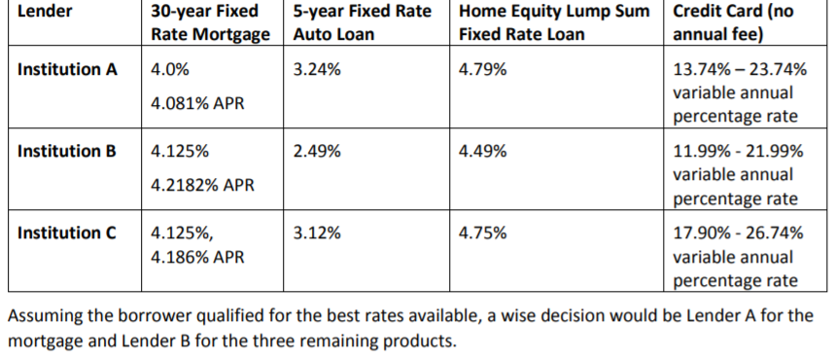
Comparing Offers

Slide 7
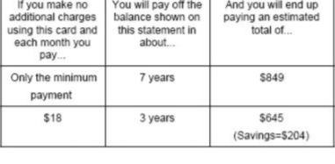
Making the min. Payment

Slide 8
Insurance
Insurance is a product purchased to guard oneself against life’s risks, specifically the financial losses associated with these risks. One may not be able to avoid dying, but one can avoid leaving loved ones in financial ruin by purchasing life insurance. The law requires people to buy certain type of insurance while other types are voluntary. The scope of this standard is to identify type of insurance and the costs and benefits associated with each type.

Slide 9

Types of Insurance
Automobile – Minimum is liability ( covers other car in accident); Collision covers your car
Health – Medical expenses . Required by law to have a certain level of insurance
Life Money to a designated beneficiary when the insured person dies.
Disability Income in case of an injury and unable to work. Short-term vs. Long-term
Property – Different types- homeowners , renters,

Slide 10
Insurance Vocab TO know
Premium – Cost to the consumer . Usually as monthly payments
Deductible – Amount of money the insured must pay when filing a claim. Higher premium means lower deductible. Vice Versa
Shared Liability – Both parties ( insurer and insurance company) have risks.
Beneficiary – The person(s) that receive an insurance payment if the insured dies.

Slide 11
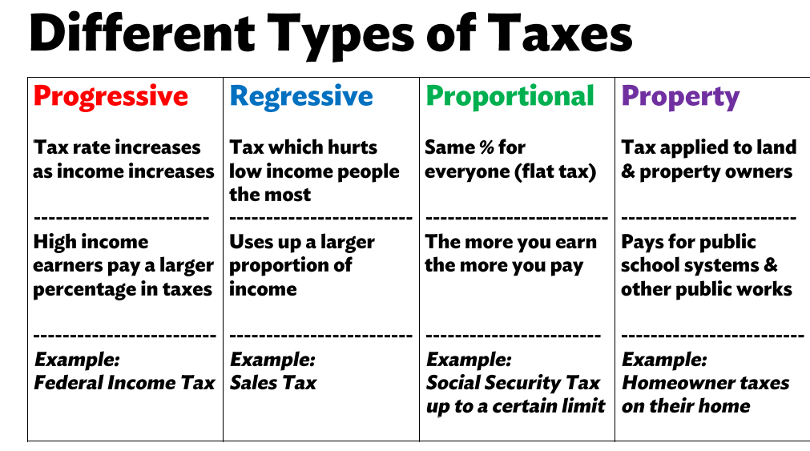

Slide 12
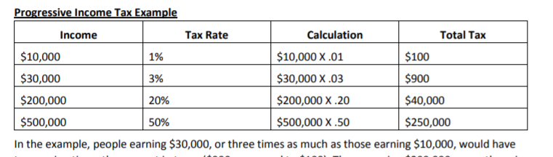
Progressive Tax Examples

Slide 13
Sales Tax Impact
All consumers purchase essential goods like food, a high sales tax on food would affect poor people more than wealthy people because both groups will be paying the same tax rate for the same good.
For this reason, sales tax is a regressive tax because it takes a greater percentage of income from a low-income person than from a high-income person. This is one reason why food is often not subject to a sales tax

Slide 14
Skills needed in the work place
Work Ethic
Punctuality
Time Management
Teamwork
Communication Skills
Good Character

Slide 15
Review From Unit

Slide 16
Investment Pyramid
Speculative
Stocks
Cash
Bonds
Higher Returns
Lower Returns
Higher Risk
Lower Risk
Mutual Funds

Slide 17
Investment Pyramid
Futures Contracts
Mutual Funds
Common Stocks
Corporate Bonds
Insured Savings Accounts
Government Bonds
Money Market Accounts
Fixed Annuities
Certificates of Deposit
Higher Returns
Lower Returns
Higher Risk
Lower Risk

Slide 18
2016 Income Tax Tables-Progressive
Tax Rate | Single | Married/Joint & Widow(er) | Married filing Separate | Head of Household
10% | $1 - $9,275 | $1 - $18,550 | $1 - $9,275 | $1 - $13,250
15% | $9,275 to $37,650 | $18,550 to $75,300 | $9,275 to $37,650 | $13,250 to $50,400
25% | $37,650 to $91,150 | $75,300 to $151,900 | $37,650 to $75,950 | $50,400 to $130,150
28% | $91,150 to $190,150 | $151,900 to $231,450 | $75,950 to $115,725 | $130,150 to $210,800
33% | $190,150 to $413,350 | $231,450 to$413,350 | $115,725 to$206,675 | $210,800 to $413,350
35% | $413,350 to $415,050 | $413,350 to $466,950 | $206,675 to $233,475 | $413,350 to $441,000
39.6% | over $415,050 | over $466,950 | over $233,475 | over $441,000

Slide 19
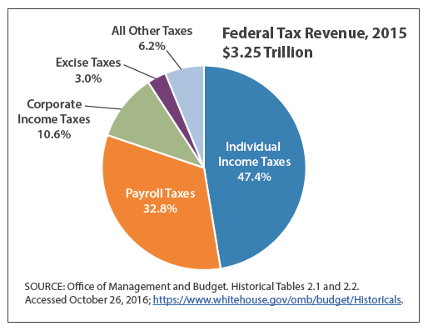
Where does the revenue come from?

Slide 20
Insurance Premiums and Deductibles
Deductibles
Premiums
$
As Premiums Increase,
Deductibles Decrease
$

