Slide 1
1/8/19
Notes
Scarcity Activity
Work on Vocab

Slide 2
Introduction to Economics
Unit 1: Chapters 1-3

Slide 3
Essential Questions
1) Why do people have to make decisions?
2) Why should people weigh the advantages and disadvantages of different alternatives when making choices?
3) Why do people not create all their own goods and services?
4) How do various economic systems answer the three basic questions differently?
5) What are the roles of government in a market economy?
6) How does investment affect productivity and economic growth?
7) How are households, business and government interrelated through markets and the flow of money?

Slide 4
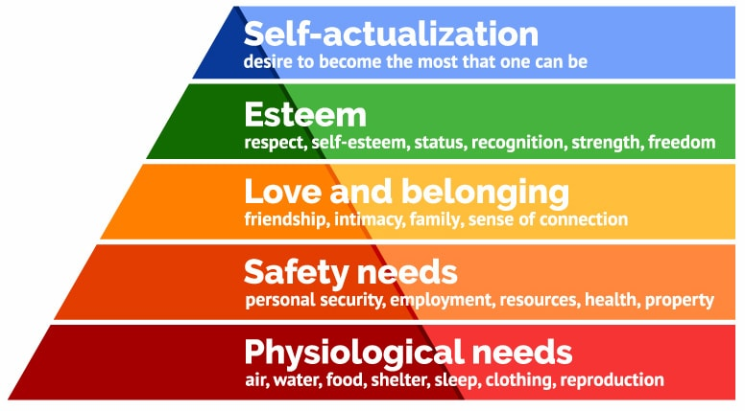
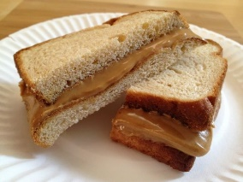
Needs VS Wants
Need
Something that is necessary for survival
Ex. Food, Shelter, Companionship
Maslow’s Hierarchy of Needs

Slide 5
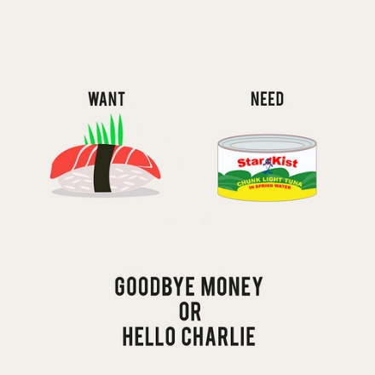
Needs VS Wants
Want
A way to express a need; may not be essential for survival
Ex. Steak, Lexus
Difference: need food, but you want a steak
Wants and needs are UNLIMITED

Slide 6
Which is which?
Water
Toy
Shoes
Groceries
Smartphone
Laptop
Housing
Clothing
Drake Concert Tickets
Tv
Aspen’s Steak house

Slide 7
What do we need to make this?
Notes:
Steel • Rubber • Glass • Car designer • Engineer • Workers at a factory • Supervisors and other bureaucracy positions • Wood grain paneling • Workers • Industrial robots • Electricity • Factory • Land for plant • Owner of company, CEO, or financial risktaker

Slide 8
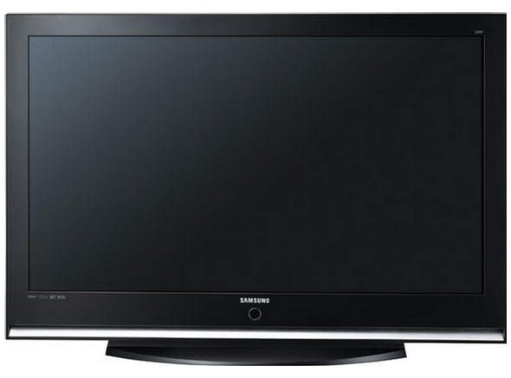
Factors of Production (FOP)
Remember: Wants and needs are UNLIMITED
We need things to meet these wants and needs
Ex. 50” Plasma TV
What do we need to make this?

Slide 9
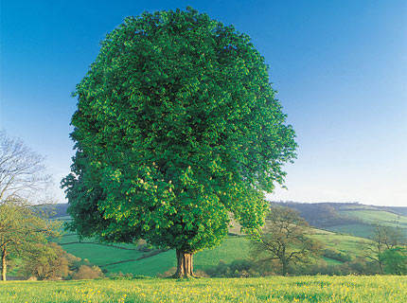
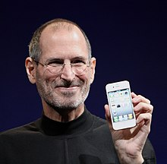
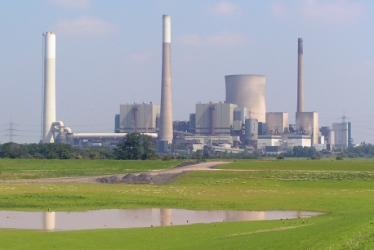
Factors of Production (FOP)
These are called the Factors of Production
Land, Labor, Capital, and Ideas or entrepreneurs
Land: “gifts of nature” such as trees, deserts, sunlight, water, cows, climate
Labor: people with their efforts, skills, and abilities
Capital: tools, equipment, and factories used in the production of goods and services. ex. bulldozer, cash register (NOT MONEY)
Entrepreneurs: risk taker in search of profit, brings all these resources together with ideas
These resources or FOP are all LIMITED

Slide 10
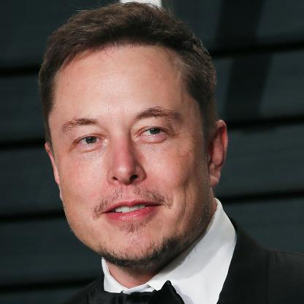
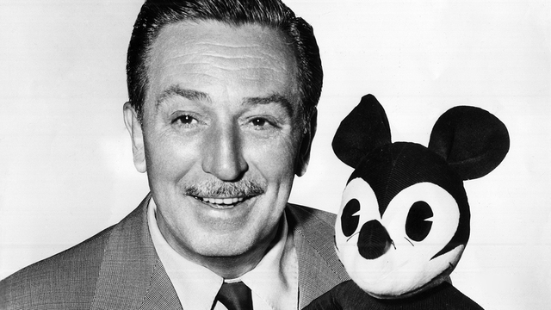
Entrepreneurs
What risks are involved with being an entrepreneur?
Why risk it?
Profit motive
Improve society
Provide jobs
Innovation

Slide 11
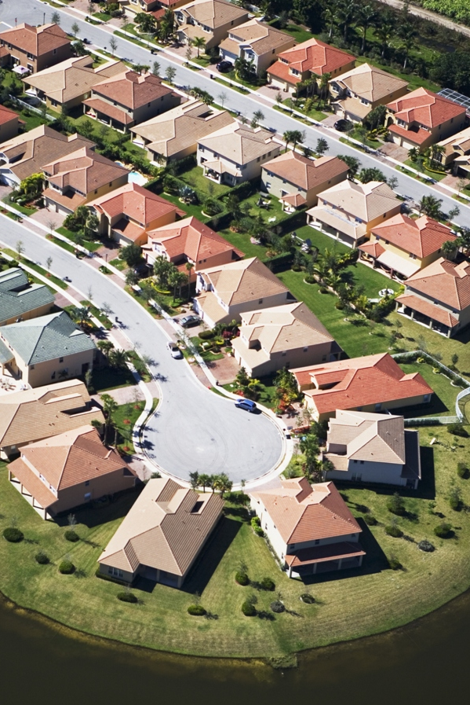
Which photo represents a limited resource ?

Slide 12
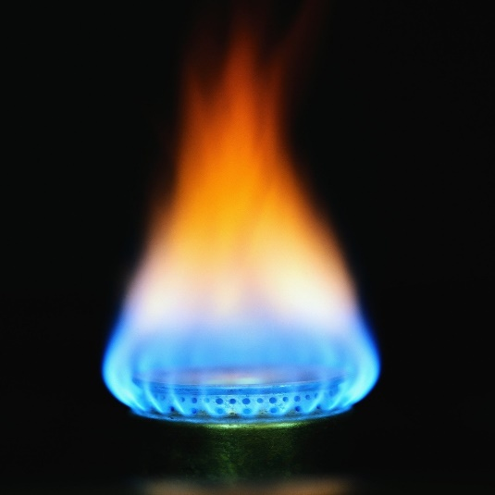
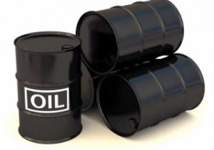
Scarcity
There are UNLIMITED wants and needs, but LIMITED resources with which to meet those needs.
Economists refer to this problem as scarcity.
Things that are scarce are both limited AND desirable
Definition of Economics: study of human efforts to satisfy what appear to be unlimited and competing wants through the careful use of scarce resources

Slide 13
Is it Scarce ?
Example | Is it limited? | Is it desirable? | Is it scarce?
Time
Water
Garbage Landfill Space
Air we Breathe

Slide 14
Check your answers
Example | Is it limited? | Is it desirable? | Is it scarce?
Time | Yes | Yes | Yes
Water | Yes | Yes | Yes
Garbage | Yes | No | No
Air we Breathe | No | Yes | No

Slide 15
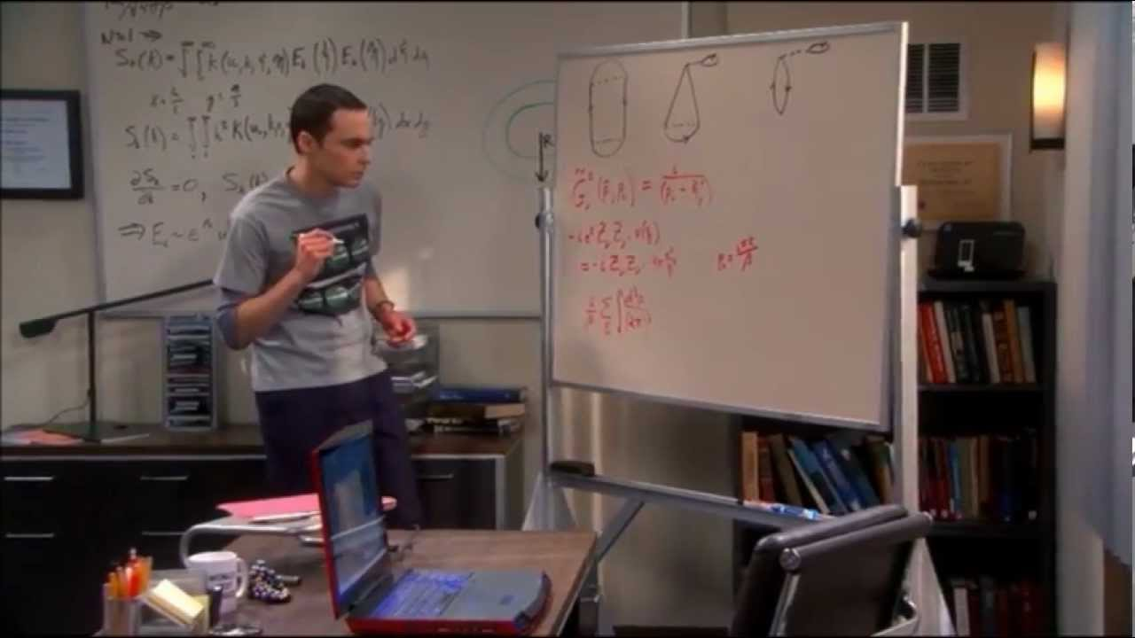
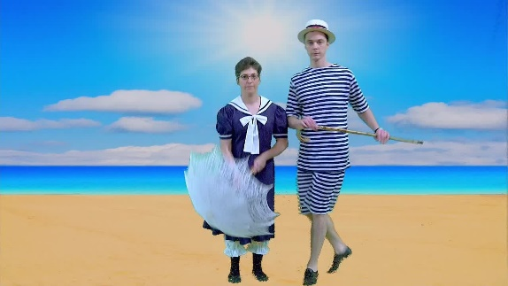
Tradeoffs and Opportunity Cost
Since resources are scarce, we as a society must figure out a way to distribute them; we must make choices.
Tradeoffs
Alternative choices for spending income and time
Vs.

