Slide 1
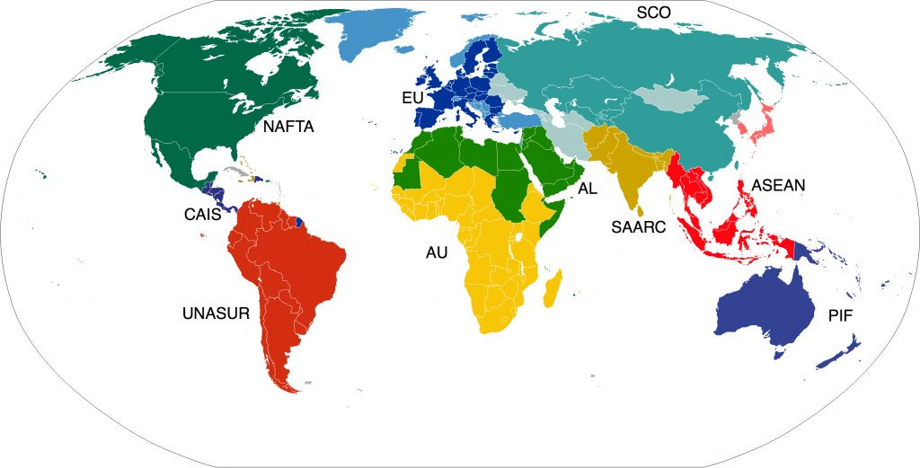
Trading Blocs
Trading blocs refer to free trade agreements among countries in a region. The goals for trading blocs may include reducing or eliminating trade barriers, increasing specialization and efficiency in production, allowing free movements of workers within the bloc, establishing a common currency, and/or coordinating infrastructure projects to facilitate efficient trade among members
Examples- NAFTA, EU, ASEAN

Slide 2
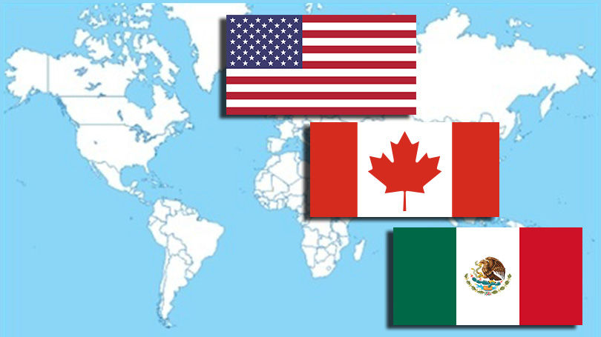
NAFTA
The North American Free Trade Agreement (NAFTA) is an agreement among the United States, Canada, and Mexico. This agreement allows for the free trade of many goods among the countries, encourages efficiency and specialization in production, and involves coordination among countries. NAFTA countries do not share a common currency or border free movement of goods and people.
USMCA- is a pending agreement to replace NAFTA

Slide 3
ASEAN
The Association of Southeast Asian Nations (ASEAN) is a trade bloc of 10 Southeast Asian countries. Like the NAFTA countries, the ASEAN countries promote free trade, specialization, and coordination among members, but do not have a common currency or border-free travel.

Slide 4
EU
the European Union (EU) had 28 member countries. Of the 28, 19 use the common currency the Euro and 26 enjoy the border-free movement of goods and people from country to country. Currently, the United Kingdom intends to leave the European Union within about two years

Slide 5
Free Trade

Slide 6
Arguments For Free Trade
Free trade increases competition, which reduces costs for buyers and improves quality of goods.
Free trade allows for domestic goods to be sold all over the world and protects export industries.
Free trade allows the country to exercise comparative advantage through specialization.

Slide 7
Arguments Against Free trade
1. To protect infant industries – markets in need of time to develop before competing against foreign rivals
2. To protect national security
3. To Protect domestic employment
4. To protect workers in developing countries from unfair labor practices
5. To protect the environment in developing countries

Slide 8
Exchange Rates

Slide 9
Exchange rate
An Exchange Rate refers to the price of one country’s currency express in terms of another country’s currency
For example, $1 USD = .88 Euro or 1 Euro = $1.13USD

Slide 10
Reading an Exchange table
 | US Dollar $1 = | Mexican Peso $1MP = | EURO €1 = | Chinese Yuan ¥1 =
US Dollar $ | $1 | $0.077 | $1.36 | $0.16
Mexican Peso $MP | $13.06MP | $1MP | $17.71MP | $2.10MP
EURO € | 0.74€ | 0.056€ | 1€ | 0.12€
Chinese Yuan ¥ | 6.23¥ | 0.48¥ | 8.45¥ | 1¥
Always read down the list. Example: $1 = $13.06MP or .74€ or 6.23¥
If a currency is strong, when they give 1 of theirs, they will get MORE THAN 1 in return.
If a currency is weak, when they give 1 of theirs, they will get LESS THAN 1 in return.
Minji travels from China to Spain. She brings 1000¥ with her. How many Euros will she get in exchange?

Slide 11
Supply and Demand
Most exchange rates between currencies fluctuate based on supply and demand.
Appreciation refers to an increase in the value of a currency relative to another.
Depreciation refers to a decrease in value of one currency relative to the other.

Slide 12
Who benefits and who loses
When it Appreciates
When it Depreciates
When a currency appreciates it gains value and those with the money can buy more.
Who wins?- good for domestic consumers (they can buy more foreign goods (foreign goods are now cheaper) = imports rise)
Who loses?- bad for domestic producers (foreign consumers will not buy as much = exports fall)
A currency can depreciate which means it gets weaker compared to other currencies.
Who wins?-good for domestic producers (foreign consumers will buy more = exports rise)
Who loses?- bad for domestic consumers (they can’t but as many foreign goods (too expensive) = imports fall)

Slide 13
Who wins ? Who loses?
Example– U.S. (USD) and Japan (Yen)
Japanese Technology is popular in the U.S.
More people demand Japanese Yen to buy Japanese goods
Yen appreciates in the foreign exchange market
Makes Japanese goods more expense for U.S. consumers and Japanese Exports to the U.S. decrease.
Higher Yen value means Japanese can import more goods more cheaply from the U.S.
Losers- Japanese exporters; U.S. tourists visiting Japan
Winners- U.S. exporters; Japanese tourists to the U.S.

