Slide 1
Prices: Supply and Demand Combined cont.
How are prices determined?
What are you trying to reach?
Market Equilibrium
Situation in which prices are relatively stable and
Qs = Qd
Equilibrium Price
The price that balances Qs and Qd.
On a graph, it is the price at which the supply and demand curves intersect.
Equilibrium Quantity
The Qs and the Qd at the equilibrium price.
On a graph it is the quantity at which the supply and demand curves intersect.

Slide 2
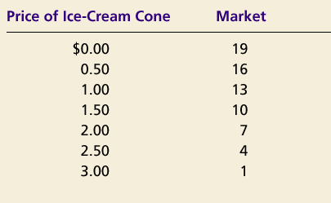
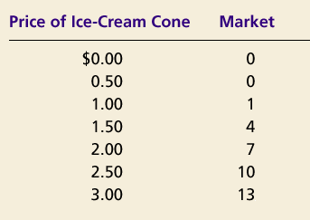
Prices: Supply and Demand Combined cont.
Demand Schedule
Supply Schedule
At $2.00, the quantity demanded is equal to the quantity supplied!

Slide 3
Prices: Supply and Demand Combined cont.
Price of
Ice-Cream
Cone
Supply
Equilibrium price
Equilibrium
$2.00
Equilibrium
Demand
quantity
0
1
2
3
4
5
6
7
8
9
10
11
12
13
Quantity of Ice-Cream Cones

Slide 4
Analyze Hamburgers
Show the change in supply or demand and say how the equilibrium price will change
1. New grilling technology cuts production time in half
2. Price of chicken increases
3. Price of hamburgers decreases
4. Price of ground beef triples
5. Human fingers found in multiple burgers.

Slide 5
Prices: Supply and Demand Combined cont.
Price of
Ice-Cream
Cone
Supply
Equilibrium price
Equilibrium
$2.00
Equilibrium
Demand
quantity
0
1
2
3
4
5
6
7
8
9
10
11
12
13
Quantity of Ice-Cream Cones

