Slide 1



Economic Indicators
How do we measure the health of our economy?

Slide 2
3 Key
Economic
indicators

Slide 3

GDP
Gross Domestic Product
  market value of all final goods and services produced within a country in a year
  Final goods are purchased by the last user and will not be resold or used to produce anything else

Slide 4


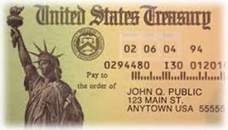
NOT Counted in GDP
Intermediate goods
  Resources of any kind
Used goods
  Ex: Used cars, purchase of an older home, thrift store clothing, Craigslist, Ebay
Illegal goods/services
  Ex: Drugs, theft etc.
Purely financial transactions
  Ex: Investment in stocks or savings
Transfer Payments
  Ex: Social Security, Food Stamps
Barter
  Ex: Babysitting for yardwork

Slide 5








4 Components of GDP
C: consumer spending
  Daily spending on goods and services
I: business investment spending
  Machinery, factories, equipment etc.

Slide 6



G: government spending
  Spending by all levels of government - military, school, highways, supplies etc.
NX: net export spending
  Purchases of U.S. goods and services by foreign buyers (exports) minus purchases of foreign goods and services by U.S. consumers (imports)

Slide 7
GDP= C+I+G+NX
Example:
  In 2000, estimates in trillions of dollars
  GDP = C + I + G + NX
  $10.04 = $6.81 + $1.87 + $1.75 + ($1.13-$1.52)

Slide 8

Unemployment
Unemployment Rate
  Percentage of labor force who is not working
  Labor Force: everyone 16 – 65 who is working or actively looking for work
  3 types of unemployment

Slide 9
Frictional
People are out of work temporarily
  Seasonal work
  Changing jobs
  Looking for 1st job
This is acceptable unemployment

Slide 10
Structural
Unemployment because your job skills are no longer needed
  Ex. Technology replaces workers so people are laid off
People can go back to school and learn new skills

Slide 11
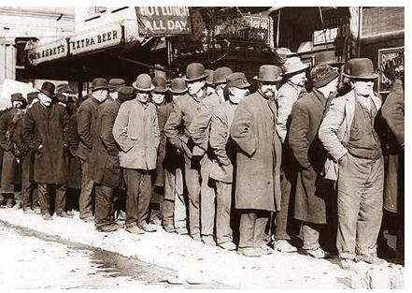
Cyclical
People are unemployed due to fluctuations in the business cycle
  As the economy declines, people lose their jobs
Worst kind of unemployment, can not easily fix. Economy must recover first.

Slide 12



CPI
Consumer Price Index
  Index of all goods and services produced in a country
  Measured by a market “basket” of all goods and services that are commonly bought year after year by the typical urban household

Slide 13
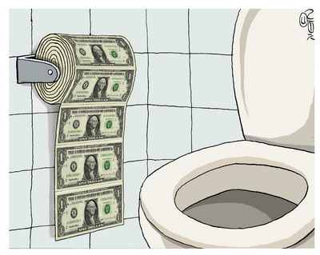
Effects of Changing CPI
Inflation
  Rising price levels
  purchasing power of the dollar falls
    Dollar buys less
Deflation
  Falling price levels
  purchasing power of the dollar rises
    Dollar buys more

Slide 14
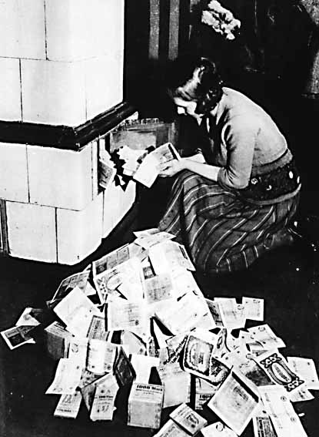
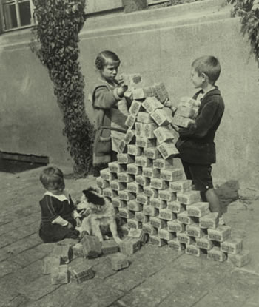
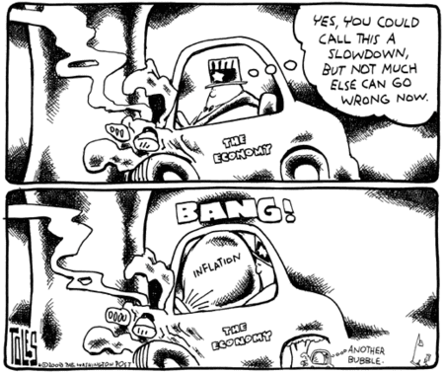
Hyperinflation: rapid inflation
ex. Germany after WWII
Stagflation: rising prices with falling GDP and rising unemployment

Slide 15
Relationship between GDP, Unemployment and CPI
As GDP rises, unemployment rates fall and prices begin to rise
As GDP falls, unemployment rises and prices begin to decline
Unemployment
GDP
Prices
Unemployment
GDP
Prices

