Slide 1
Determinants of Demand
Change in Demand
Income of consumers
Number of consumers
Substitute price change
Expectations
Complement price change
Tastes or preferences
This results in a shift in the demand curve, either to the left or right.
Causes a change that alters the quantity demanded at every price.

Slide 2
Shifts in the Demand Curve
An increase is always to the right and a decrease is always to the left.
Price of
Ice-Cream
Cone
Increase
in demand
Decrease
in demand
Demand
curve,
D
2
Demand
curve,
D
1
Demand curve,
D
3
0
Quantity of
Ice-Cream Cones

Slide 3
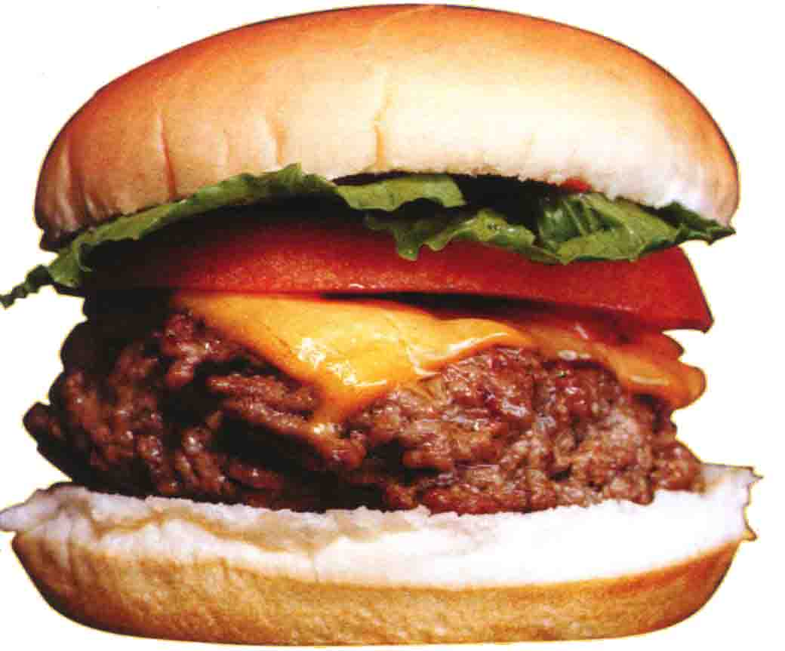
Shifts and Changes in Demand cont.
A closer look at changes in income
Normal Good
A good that consumers
demand more when their
incomes increase
Inferior Good
A good that consumers
demand less when their
incomes increase

Slide 4
Consumer Income Normal Good
Price of Hamburgers
$3.00
An increase in income...
2.50
Increase
in demand
2.00
1.50
1.00
0.50
D₂
D₁
Quantity of Hamburgers
0
1
2
3
4
5
6
7
8
9
10
11
12

Slide 5
Consumer Income Inferior Good
Price of Spam
$3.00
2.50
An increase in income...
2.00
Decrease
in demand
1.50
1.00
0.50
D₁
Quantity of Spam
0
1
2
3
4
5
6
7
8
9
10
11
12

