Slide 1
Unit 2: Microeconomics

Slide 2
Circular Flow Model

Slide 3
Circular Flow Diagram
This shows us the relationships that exist between household and business in the economy

Slide 4
Households role in the economy
Resource(factor) market- own the productive resources (factors of production) in the circular flow model. They sell land, labor, capital and entrepreneurship to businesses for income payments.
Land--- Rent Labor--- Wages Capital--- Interest Entrep.---Profit
Product Market- consumers of goods and services. Buy goods and services from businesses. They spend the income they earned in Resource Market to buy these goods and services.

Slide 5
Businesses role in the economy
Resource Market- consumers of the productive resources (factors of production). They purchase the use of land, labor, capital, and entrepreneurship using revenue they earn in the Product Market.
Product Market- producers of goods and services. They sell goods and services to households to earn revenue .

Slide 6
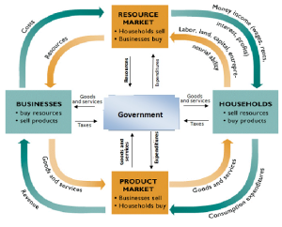
Governments Role in Circular Flow
Product Market- consume products from businesses (i.e. Firetrucks) and pay for them.
Resource Market- buy resources (i.e. Teachers) in the resource market and pay for them.
Businesses- Provides public goods (i.e. roads, bridges, fire stations) and subsides. They then collect taxes from businesses.
Households- Provides public goods and welfare services. Collects taxes to pay for these

Slide 7
What goes where?

